Slide 1
PERSONAL DEVELOPMENT PLANNING
ASHE TUTORIAL DAY ONE SEPT / DEC 2023

Slide 2
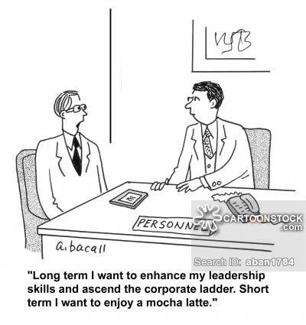
What is Personal Development Planning ?
PDP is a structured and supported process
undertaken by an individual to reflect
upon their own learning, performance
and / or achievement and to plan
for their personal, educational and
career development. (QAA 2001).

Slide 3
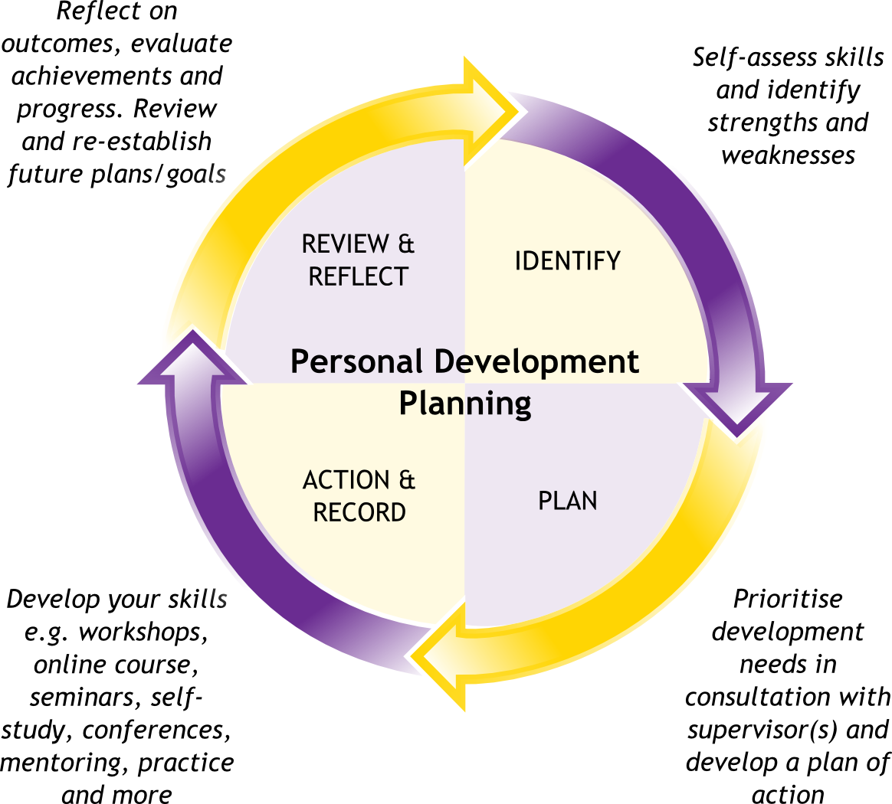
What is Personal Development Planning ?

Slide 4

Let’s watch a video on PDP…

Slide 5
We will look at ….
  Self-awareness skills
  Personality (research on your own)
  Motivation (research on your own)

Slide 6
  Self-awareness skills
Self-awareness means:
  knowing your values, personality, needs, habits, emotions, strengths, weaknesses, etc.
With a sense of who you are and a vision of the person you want to become, a plan for professional or personal development can be created.
SA allows you to motivate yourself and manage your stress better
SA helps you with your intuitive decision making
SA helps you to lead and motivate others more effectively
In short Self-awareness is very useful.

Slide 7

More on self awareness

Slide 8


